Slide 1




Communicating your results
Teresa F. Fernandes
Heriot-Watt University, Edinburgh, UK

Slide 2

Why report your research?
To publicise your findings
To create interest in your research area
To let people (managers/public?) know what’s happening
To allow others to comment, add, suggest
To raise funding for that area of work
To expand on the body of knowledge
To get a degree (and a good one!)
To get a job
LLP – Erasmus – Erasmus Network

Slide 3
Oral
Written
Audience and purpose
LLP – Erasmus – Erasmus Network

Slide 4
Suggestions for a good Power Point Presentation
Good title page with your name, co-authors, affiliation
Introduction
Aims, Null Hypotheses
Methods – Pictures, brief details
Results – Figures, Tables, p-values (asterisks)
Brief summary of main findings
Discussion – explanation, ideas, context
Conclusions and further work
LLP – Erasmus – Erasmus Network

Slide 5
Introduction
It is useful to introduce both yourself and the topic that you will discuss. Therefore, include on the first slide the title of your topic, your name and where you come from and on the second slide a short introduction of the topic (remember that this will simply be a bullet point and you will talk around it).
Text on slides
Text should be mainly bullet points or short pieces of information. It is after all an audio-visual presentation, not just a visual presentation. The audience is expecting to hear you speak on the subject not read all the information from the screen. Check font size (24+ is good!)
LLP – Erasmus – Erasmus Network

Slide 6
Bullet points on slides
Too many bullet points on each slide would indicate a lack of proper summary. Better to break down the subject further and use more slides or perhaps roll over onto another slide.
Choice of colours
There is a need to consider the readability of slides and lack of contrast can cause great difficulty. Text over photographs can make text difficult to read, as can various combinations of text colour and background colour. Use high contrast schemes such as white/yellow text on dark blue/black background.
LLP – Erasmus – Erasmus Network

Slide 7
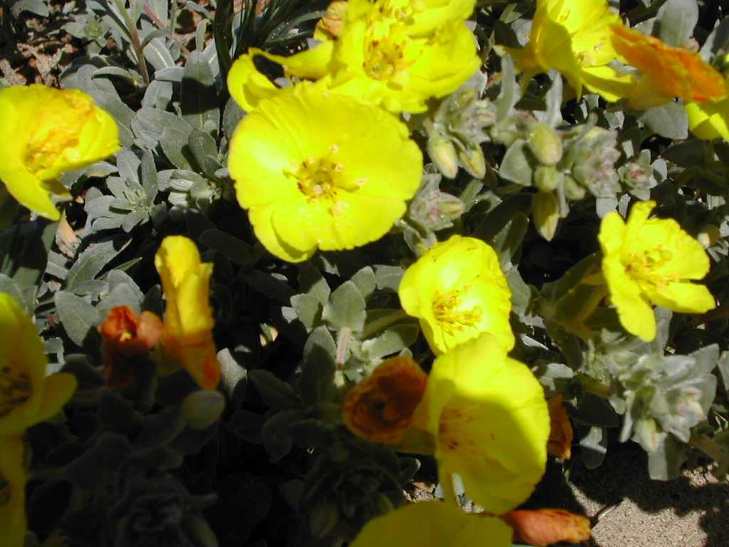
Bullet points on slides
Too many bullet points on each slide would indicate a lack of proper summary. Better to break down the subject further and use more slides or perhaps roll over onto another slide.
Choice of colours
There is a need to consider the readability of slides and lack of contrast can cause great difficulty. Text over photographs can make text difficult to read as can various combinations of text colour and background colour. Use high contrast schemes such as white text on dark blue background or dark green background. Some of the installed PowerPoint templates have excellent high contrast schemes.

Slide 8
Too much animation
Some presentations contain far too much animation, i.e., individual letters flying onto the slide, a mixture of animation effects, multiple pictures flying on. This can be distracting and it may take longer to introduce text than would be sensible when presenting to an audience.
Too little animation
In contrast to the above, a little animation will allow you to introduce headings (bullet point) to the audience one at a time, thus preventing the audience reading ahead of you and not listening to what you are saying.
LLP – Erasmus – Erasmus Network

Slide 9
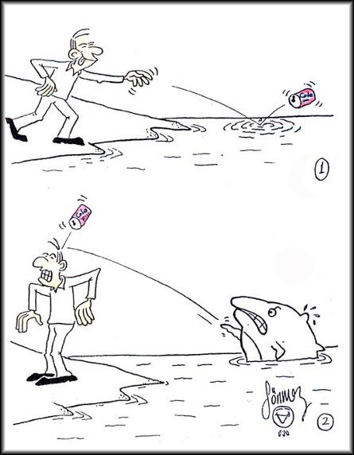
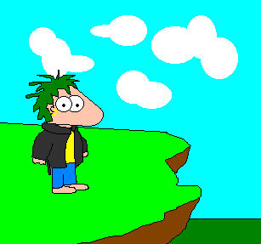


Too much animation
Some presentations contain far too much animation, i.e., individual letters flew onto the slide, a mixture of animation effects was used, multiple pictures flew on.
This can be distracting and it may take longer to introduce text than would be sensible when presenting to an audience.
Too little animation ?
In contrast to the above, a little animation will allow you to introduce headings (bullet point) to the audience one at a time, thus preventing the audience reading ahead of you and not listening to what you are saying.

Slide 10
Use of sound effects
Some presentations use sound effects. This can be very distracting in a scientific presentation and is rarely appropriate.
Use of sound effects
Some presentations use sound effects.
This can be very distracting
It is rarely appropriate in a scientific presentation
LLP – Erasmus – Erasmus Network

Slide 11
Results
Too many figures, tables, charts, etc, may confuse your audience. Stick to the essential points and summarise them at the end so that the message is not lost. Guide your audience.
23%
36%
Ford, Fernandes et al (2004)
Ford, Fernandes et al (2004)

Slide 12
Failure to summarise properly
The bullet points on the slides should relate to the major points in the subject matter that you are presenting. You should then be prepared to speak and expand upon these.
You should include a summary at the end of your talk, to draw together the main points and reinforce what you have presented.
It is always good practice to provide information on possible future developments.
Leave time at the end for any questions.
LLP – Erasmus – Erasmus Network

Slide 13
Pace and presentation style
Do not speak too fast (or too slowly).
Use your notes and practice your talk beforehand.
Know the set up of the room and the time you have been allocated. If you have 20 minutes, do not prepare more than 15 slides.
Do not read your notes, speak up, do not stand in front of the screen and do not turn your back to the audience. Spell check your slides.
Know your audience – generally jokes do NOT go down well.
RELAX – You will get a nice BUZZ from it all!
LLP – Erasmus – Erasmus Network

Slide 14
Written Presentation
Know your audience:
Style – general public, expert scientific, managerial ?
Scientific paper
Thesis
Report
LLP – Erasmus – Erasmus Network

Slide 15
Scientific Paper
Consult scientific literature:
Appropriate field
Appropriate audience
Short/long communications
Impact factors (Nature and Science: 30, Coral reefs: 1.25, MEPS: 1.9, JEMBE: 1.3)
Be realistic
Once decided on journal, follow ALL guidelines, get feedback from supervisor, friends and colleagues, contact editor, if needed
LLP – Erasmus – Erasmus Network

Slide 16
Thesis (honours, Masters, PhD)
Follow guidelines (supervisor, project coordinator, admin):
Length, style, margins, font size, etc
Structure:
Title and author
Table of contents
Acknowledgements
Abstract
Introduction (Aims, Objectives, Null Hypotheses)
Material and Methods
Results
Discussion
References
Appendices
LLP – Erasmus – Erasmus Network

Slide 17
Abstract – to tell the reader what the report contains; it should be short and to the point a single paragraph.
Introduction - this should describe the background and the aims of the investigation, including Aims and Null Hypotheses. References should be used throughout to back up information provided.
Methods - this should give a detailed account of any theory and methods used. As a minimum, descriptions should contain enough information to allow an expert to repeat your measurements. It is important to give values or details for any variable part of the method (e.g. sample size or volume, spectrophotometer path-length, calibration constants). If indices are calculated the formulae should be given together with relevant references. References for all methods used should be included.
LLP – Erasmus – Erasmus Network

Slide 18
Results
This section provides the main results. Subsidiary findings could be included in an Appendix, if required.
Results should be presented in either Tables, Figures or Diagrams. Different methods should not be used to illustrate the same data. Results from statistical tests should be presented adequately.
Figures should be labelled appropriately. Table titles should be placed at the top of the Table whereas Figure legends should go at the foot of the Figure. Data presented in Figures/Tables/Diagrams will need to be described in the text.
LLP – Erasmus – Erasmus Network

Slide 19
General Discussion
Should include how the results relate to previous findings and to the stated aims, how successful the investigation was and whether improvements could have been made to the investigation.
The conclusions and recommendations from results should be stated clearly. Recommendations may be put in a separate section if they form a large part of the project.
Suggested future developments should be indicated.
LLP – Erasmus – Erasmus Network

Slide 20
References
Normally author name and date only in the main body of text and a detailed alphabetical list of references in the reference section.
There are different styles that can be used. For example, for books, give author; in brackets date of publication; title; publisher; place of publication, e.g. Cox, D. R and Snell, E. J. (1981). Applied Statistics: Principles and Examples. Chapman and Hall, London.
For journal articles, give author; in brackets date of publication; title; journal; volume number; page numbers, e.g. Sewell, W.H. and Shah, V.P. (1968). Social class, parental encouragement and educational aspirations. American Journal of Sociology, 73, 559-72. Citation of web pages should be avoided in scientific reports. If absolutely necessary, however, the full citation should include authors (if any), title, web address, and date of consultation.
LLP – Erasmus – Erasmus Network

Slide 21
Points to consider
Style – should NOT be personal, jokey, casual
You should write in a rigorous and clear manner
Review the literature but be CRITICAL in your analysis
Be clear when stating your aims
Describe your results within the Results section
Discuss your results within the Discussion and go back to the points made in the Introduction
Plagiarism – be clear about it and avoid it!
Copyright – obtain information regarding use of material from the web or any other sources (inc. photos, maps, diagrams, etc)
LLP – Erasmus – Erasmus Network

Slide 22
Essay / Review
Consider the topic to be covered carefully
Decide how to subsection the topic
Provide background information
Review the evidence
Suggest different (contradicting?) views
Discuss the different aspects
Conclude
LLP – Erasmus – Erasmus Network

Slide 23
(Management) Report
Non-executive Summary
Style rigorous but not “over-scientific”
Less stress on scientific sources of information (but not always – it does depend on circumstance!)
LLP – Erasmus – Erasmus Network

Slide 24
Poster
Clear message
Make use of visuals, including colour, images, graphs
“Less is more” -
Know your audience
LLP – Erasmus – Erasmus Network

Slide 25


Slide 26
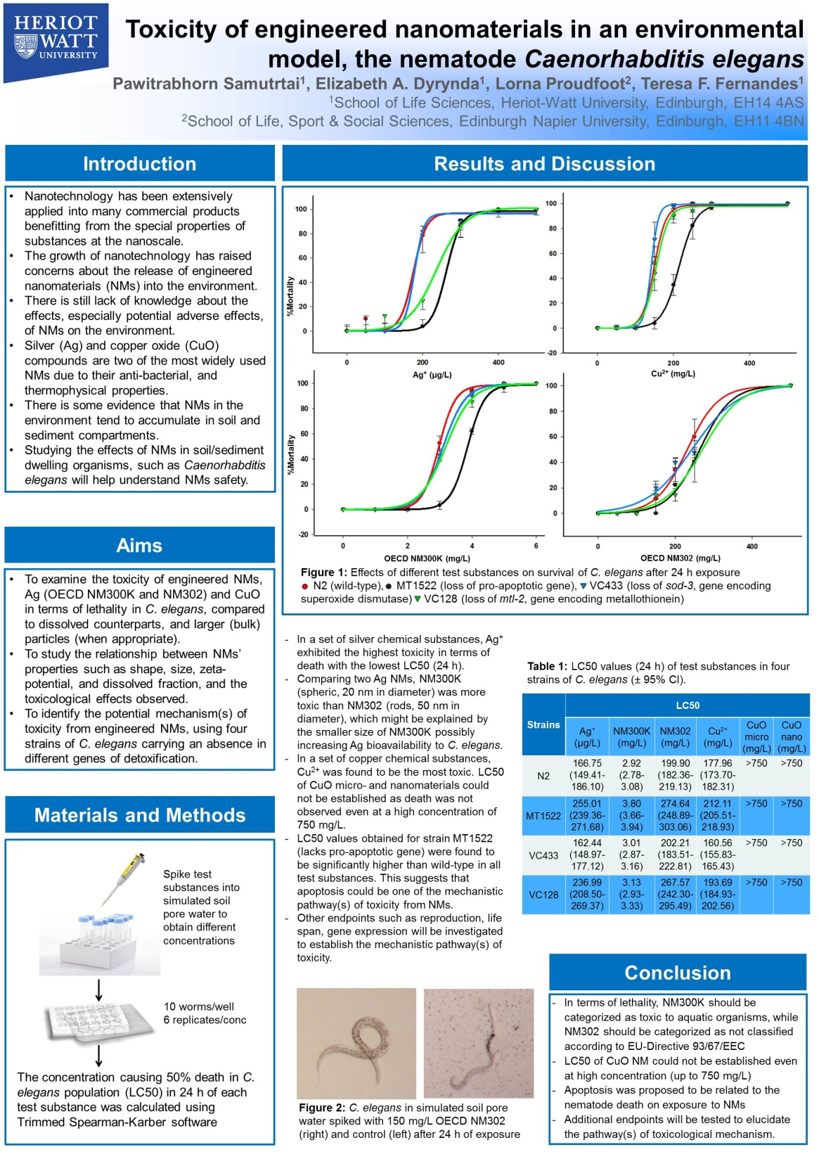

Slide 27
Summary
Know your audience
Know your purpose
Be clear, simple, and direct, but RIGOROUS
Inspire and enthuse your audience
LLP – Erasmus – Erasmus Network

Slide 28

Contact us
Thank you for your attention
Email: info@aquatnet.com
Website: www.aquatnet.com
Notes:
28

Slide 29
NOTICE
This material has been produced as an output of the AQUA-TNET project which has
Received funding support from the European Commission Lifelong Learning Programme. The content reflects the views only of the author(s) and the Commission cannot be held Responsible for any use which may be made of the information contained herein.
The work is released under a Creative Commons Non Commercial Share Alike 4.0
International Licence, although any elements (such as graphics) that may be covered by individual copyright licenses retain that original licence. You are free to
adapt this work and use it for non-commercial purposes provided you retain this notice and the terms that it provides.
Training Materials by AQUA-TNET is licensed under a Creative Commons Attribution-NonCommercial-ShareAlike 4.0 International License.
LLP – Erasmus – Erasmus Network

